Slide 1

Engineering Design Process
The Antidote - FTC 14320

Slide 2
Engineering Design Process
A series of steps that engineers follow to design a solution to a problem.
The engineering design process helps in making decisions by applying the principles of science, math and engineering.
Ask
Improve
NASA
Engineering
Design
Process
Brainstorm
Test
Prototype
Fabricate
Our FTC version of the NASA Design Process

Slide 3
Design Process Steps
Step 1 – ASK – Identify the Problem
Step 2 – BRAINSTORM – Brainstorm Solutions and Research Ideas
Step 3 – PROTOTYPE – Select 2 or 3 Promising Solutions
Step 4 – FABRICATE – Construct a Working Model
Step 5 – TEST – Test & Evaluate Solutions
Step 6 – IMPROVE – Improvise, Adapt, Overcome your Design

Slide 4
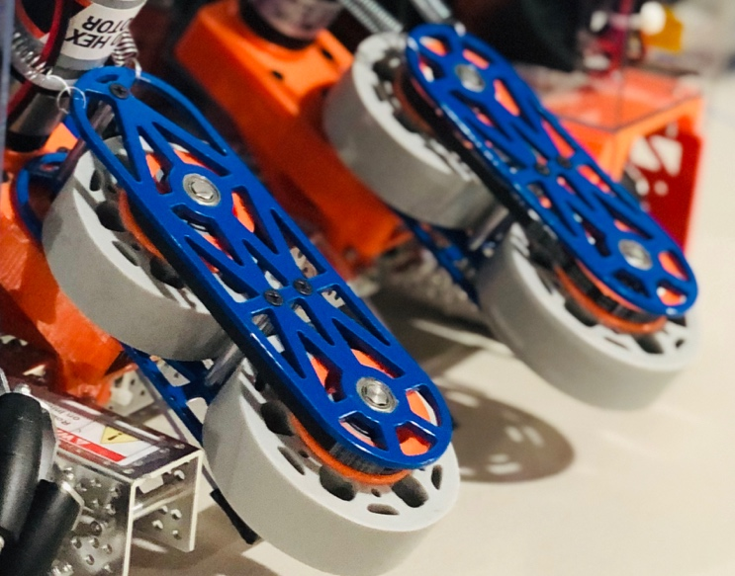
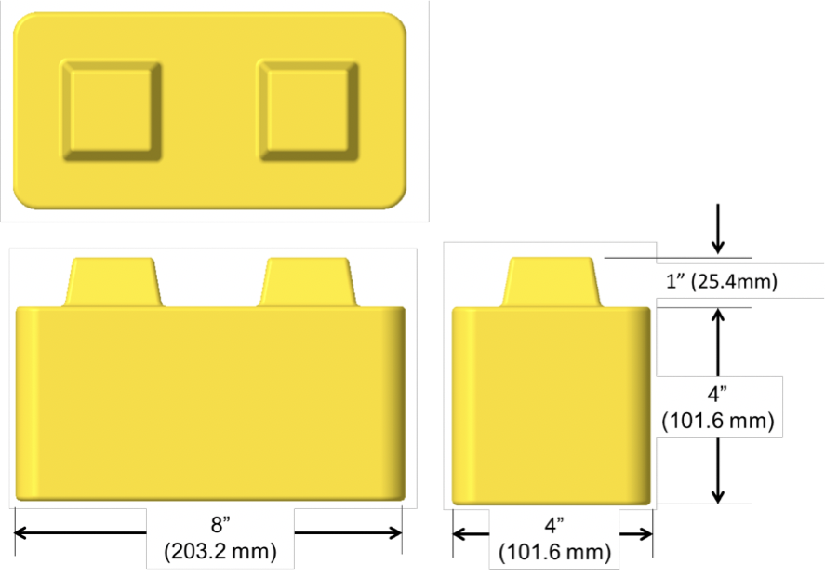
Identify the Problem
Identify what needs to be accomplished
What are the Restrictions/Constraints
Robots must not be taller than 14 inches to cross Sky Bridge
Functional Requirements
The robot must be able to intake stones from all angles
Analyze game and determine strategies
Identify tasks and rank in priority

Slide 5
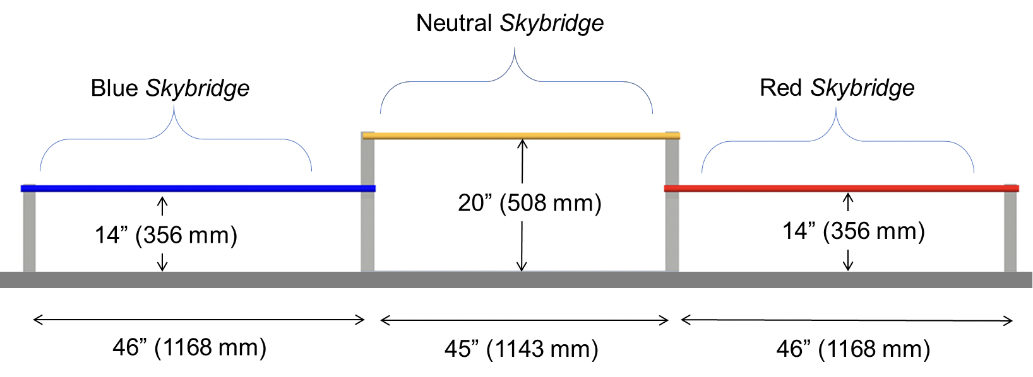
Design Constraints
Maximum robot height/weight
SkyStone → 18x18x14, 42 lbs.
Number of allowed motors → 8 motors
Maximum #of game elements
Allowed Control Systems

Slide 6
Identify and Rank Tasks
There are numerous tasks to accomplish in each FTC Game
List them out and analyze their point values and difficulty
E = Easy (can be completed ~90%)
M = Medium (can be completed ~70%)
H = Hard (can be completed ~50%)
These difficulties vary for each team!
Tasks | Point Value | Difficulty | Rank
Repositioning | 10 | 4 | H
Navigating | 5 | 1 | E
SkyStone Delivery | 10 | 5 | H
Stone Delivery | 2 | 3 | M
Placing | 4 | 3 | M

Slide 7
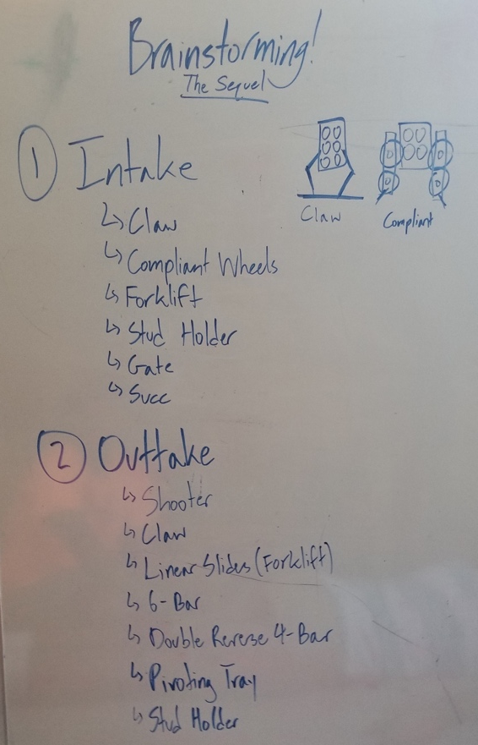
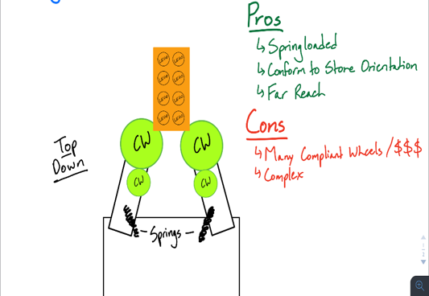
Brainstorm Ideas
Come up with numerous ideas to accomplish the task
Don’t be afraid to produce unique and creative ideas!
No idea is a bad idea
List each idea down on a whiteboard
Go through the pros/cons of each idea
Do a lot of research on YouTube
Look for real-world solutions
FTC teams share their ideas (previous games)

Slide 8
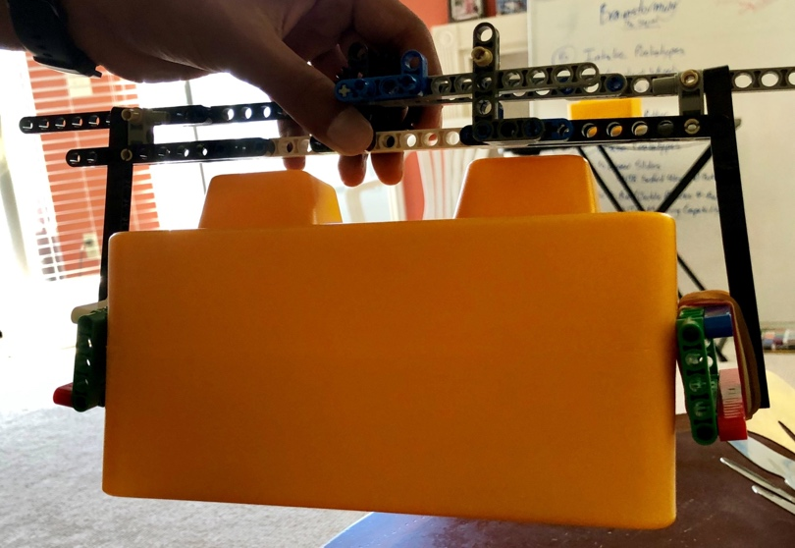
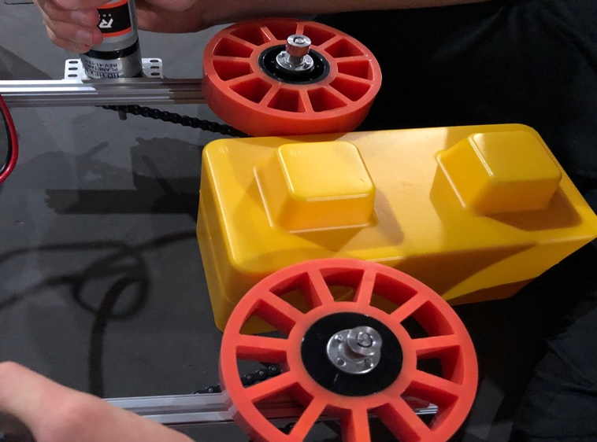
Prototype a Solution
Select a few promising solutions to prototype
Does not need to be perfect
Rough idea of how the process works
Ex: Using AndyMark Compliant Wheels as an intake
Use any material!
Cardboard, LEGOs, 3D Printing

Slide 9
Decision Matrix
Use a Decision Matrix/Weighted Objective Table to help select one method over other ideas in accomplishing a single task
Compares each idea regarding different criteria
Ex: Different ways to hold on to the SkyStone
Weights are used to establish the importance of the criteria
Characteristic & Weight |  | Nub Grabber | Side Clamp | Linear Actuator
Driver Precision/Ease of Alignment | 4 | 3 | 3 | 1
Size | 3 | 4 | 3 | 1
Reliability | 4 | 1 | 3 | 2
Ease to Manufacture | 2 | 4 | 3 | 2
RESULT |  | 36 | 39 | 19

Slide 10
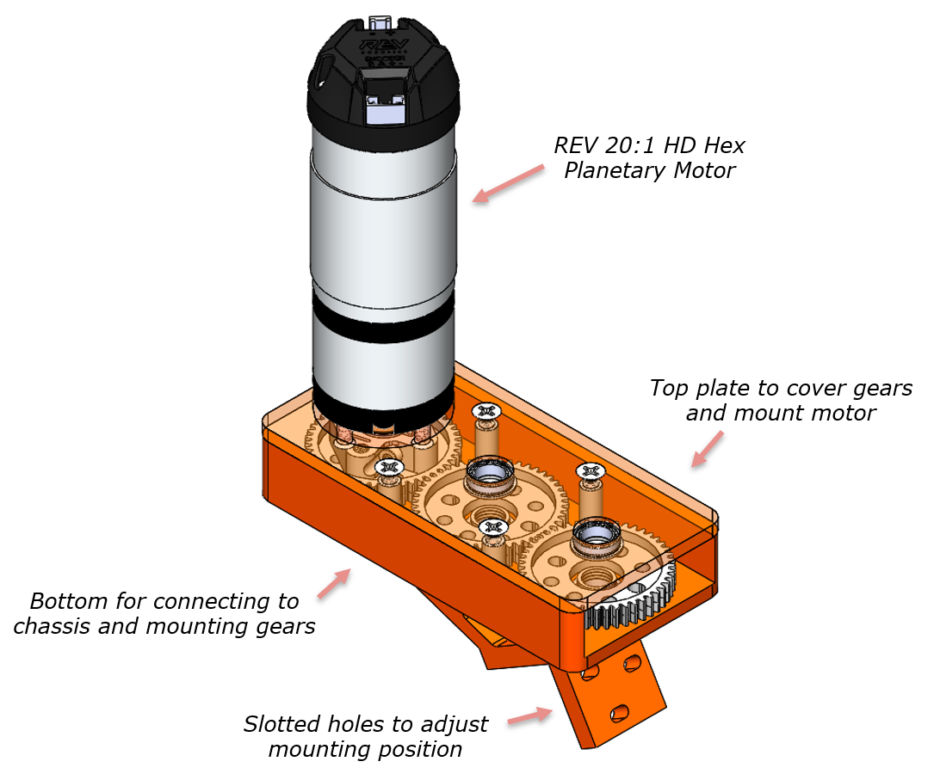
Fabricate the Design
Creating the first complete working design of the idea
This step is accomplished after any issues in the prototype have been resolved
Use Computer Aided Designing (CAD) software to create the design
Use any material!
Build Kits
Actobotics, goBILDA
3D Printing
Aluminum

Slide 11
Test the Design
Often the most rigorous part of the design process
Involves pushing the design to its limits
Does it work?
Is it reliable/efficient?
Is it robust?
Is it too complicated?
Does it meet all specifications listed in the Ask phase?
Record measurements and take notes as the design is tested
Manipulate only one variable at a time when testing for accurate results
Changing too many things at once → Do not know what changed what

Slide 12
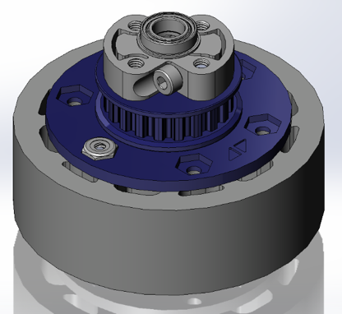
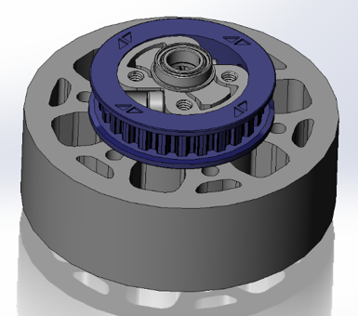
Improve and Redesign
After testing, is there anything that can be changed to be more efficient? reliable? accurate?
This phase is the ‘end’ of the process, creating the design process cycle
Endless loop of constantly improving the design (aka iterating)
The process outlined here isn’t the only process in designing a robot, each team typically finds a process that works for them
Simpler design → thinner, no screws

Slide 13

Credits
This lesson was written by The Antidote 14320 for FTCTutorials.com
You can contact the author at:
Website:
http://theantidoterobotics.com
Twitter:
@theantidoteFTC
Email:
theantidoteftc@gmail.com
More lessons for FIRST Tech Challenge are available at www.FTCtutorials.com
This work is licensed under a
Creative Commons Attribution-NonCommercial-ShareAlike 4.0 International License.

